Slide 1


MED5606: Evaluation of Machine Learning Methods for DHIs
Ryan Field
Ryan.field@glasgow.ac.uk

Slide 2
Machine Learning in R

Slide 3
Data Sets
Downloaded from:
https://archive.ics.uci.edu/ml/datasets/heart+disease
https://archive.ics.uci.edu/ml/datasets/Breast+Cancer+Wisconsin+%28Diagnostic%29
https://archive-beta.ics.uci.edu/ml/datasets/heart+disease
https://archive-beta.ics.uci.edu/ml/datasets/breast+cancer+wisconsin+diagnostic

Slide 4
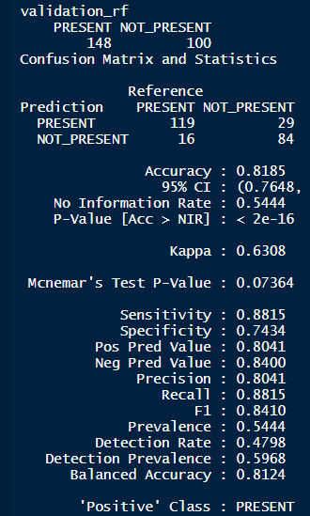
Confusion Matrix
Notes:
No information Rate: how the model will perform if it were to pick the majority class
Kappa – Comparison of observed accuracy with and expected accuracy (including if we randomly picked) anything better than 0.4 is good?
Mcnemar – Whether on label is predicted more accurately than the other (Homogony of labels)
Sensitivity – Same as Recall – True positives / actual positives
Specificity – True Negatives / actual negatives
Precision - True positives / predicted positives
Pos pred value: Rate of Positives captured among the total Pos Predicted
Prevalence is the the rate of "All ACTUAL Postives" in the whole population
Detection rate is among total population, how much is detected
Detection prevalence is rate of "All PREDICTED Positives" in the whole population
Balanced Accuracy is the average of Sensitivity and Specificity
F1: Equally weighted average of Precision and Recall; because these are rates, we have to use harmonic mean. Harmonic mean of Precision and Recall,

Slide 6
Questions
What happens to accuracy if you change the % split
Does imputation method make a difference?
What other ML algorithms could you try
Notes:
Bagging (Bootstrap aggregating)
When used in missing value imputation, it will use the remaining variables as predictors to train a bagging tree and then use the tree to predict the missing values.

